Slide 1
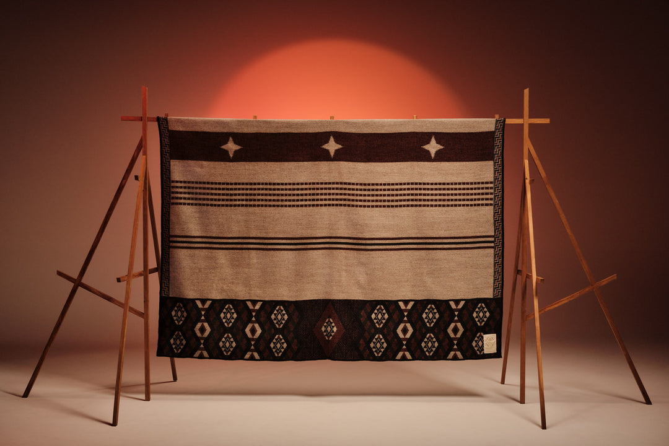
Ruahinetanga
Te Harakeke
Dr Kelly Bullivant

Slide 2
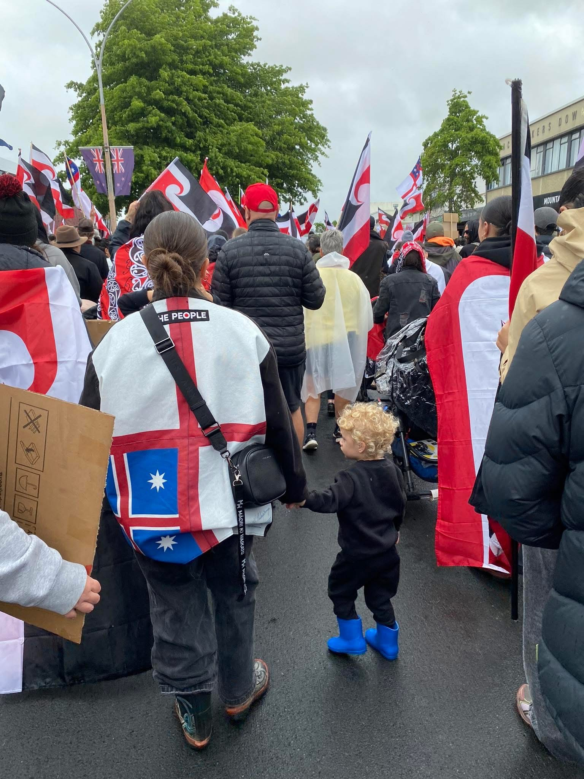
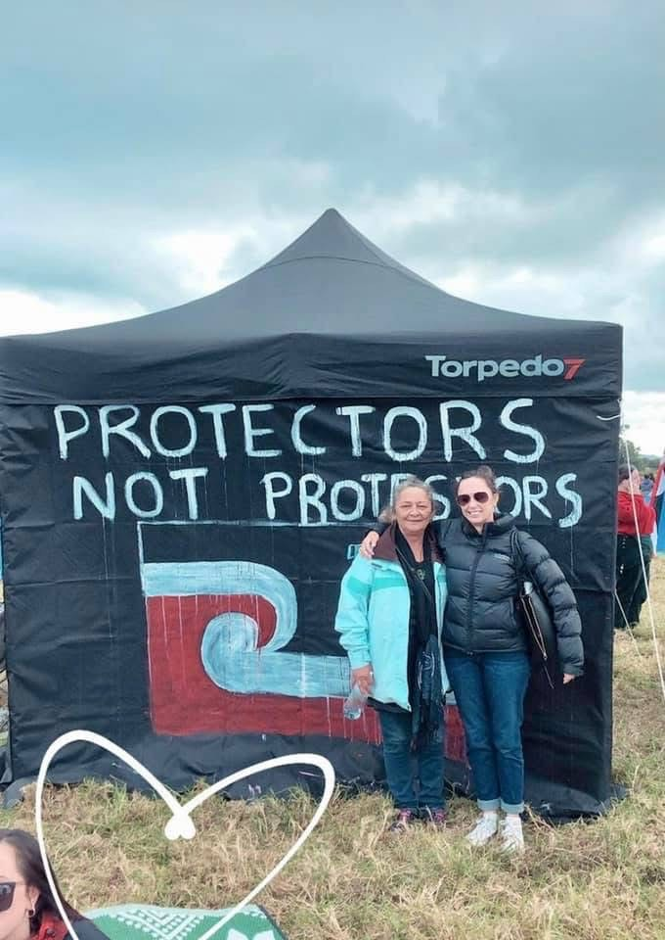
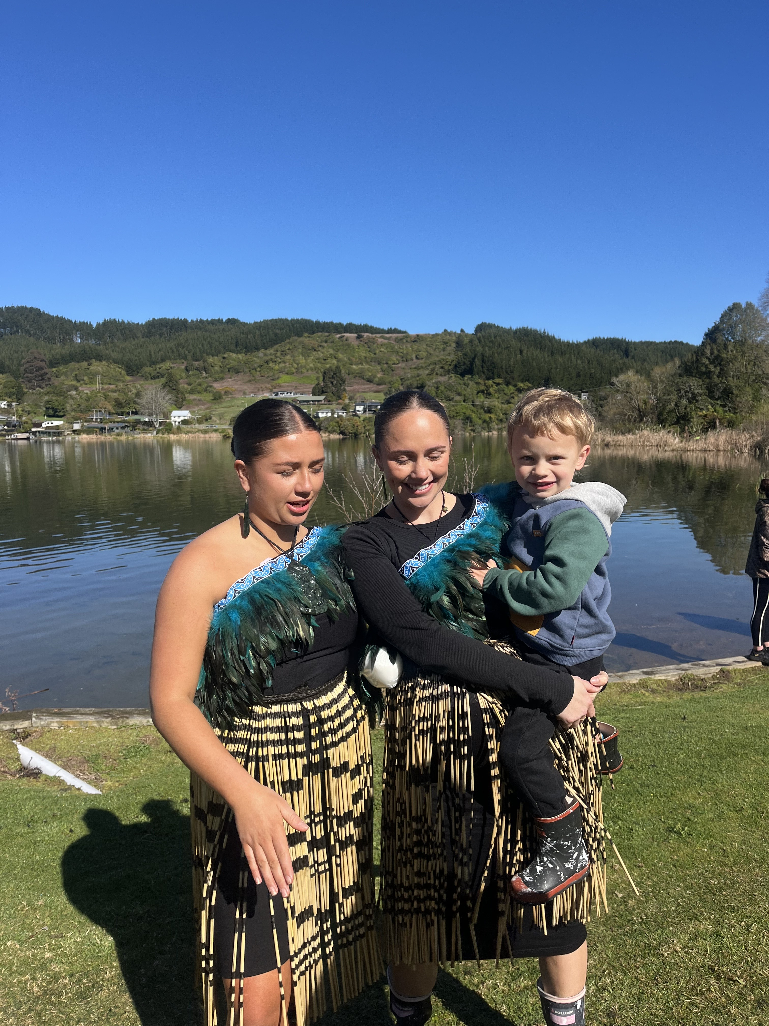
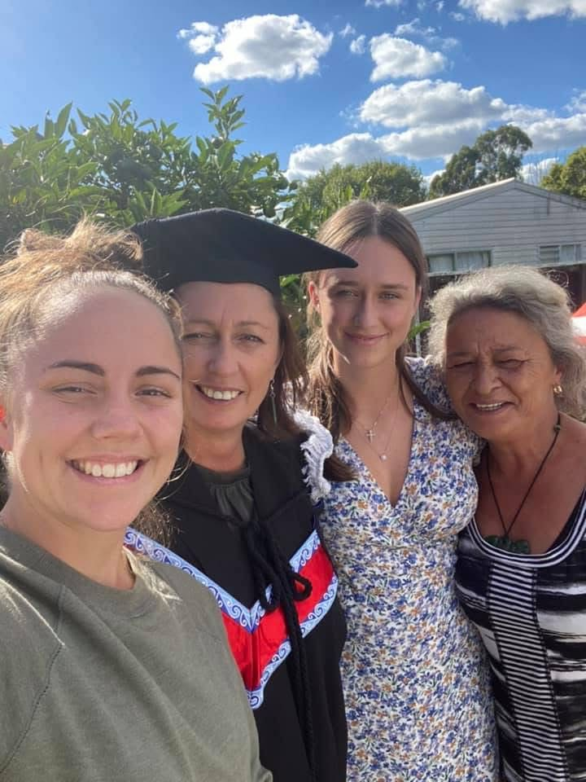
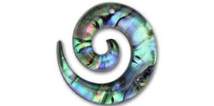
Ko wai au
He uri ahau nō Ngati Pikao, nō Ngati Rongomai hoki
Ko Kelly toku ingoa

Slide 3
E aku rangi paruhi,
E aku huia kaimanawa,
E aku toka tū moana
E kore e ea i te kupu ki te whakamihi atu.
A beautiful day, my people who bring me warmth
My greatest treasures
My people that stand as rocks in ocean against the coarse tide
There are no sufficient words to thankyou.
Ko te oranga te tangata, ko te oranga te whenua,
Ka karapinepine te pūtoto.
Life is in the people and life is in the land
The assembling of flesh to create woman
He wāhine he whenua e ngaro ai te tangata.
Me ko Te Ao Kapurangi
e tū nei ki ngā maihi
For woman and for land have essential roles that mankind would be lost without.
As if you were Te Ao Kapurangi
Standing on the mast of the house
Me ko Papatuanuku e takoto nei
Me aro koe ki te hā o Hine-ahu-one
As if you were earth mother laying beneath us
Pay heed to the breath of life-women
Te mana o te wāhine
ki roto kē
kiato te kakano
ka wana te kakano
ki roto ko te whare tangata
The mana of the women
Comes from the inside
The seed is safe
The seed comes to life
Inside the house of humanity
Ka tō te rā
Haruru te whenua
Mā te wahine ka ora ai te Iwi
When the day ends
And the land rumbles
It is for the women that the tribe survives
Nei noa ngā kupu
Whakamihi i ngā wāhine
Kia rangitira, he taniwha hikuroa
These are the words
Of thanks to women
To make them a chief, and who are of great mana Mia Bullivant

Slide 4
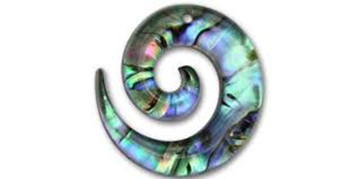
This pukapuka invites you to explore understandings and lived experiences that wāhine Māori have shared about menopause.
I believe our ancestors have given us all we need to know to be able to live well today. In this way I hope that the themes in this pukapuka will give us a new language for talking about menopause and new understandings of what constitutes ruahinetanga for wahine Māori.
Some of this korero might resonate with you, some might not, there is no one way to experience menopause. This pukapuka is a space for learning, reflection, and connection—where your own whakaaro is welcome.

Slide 5
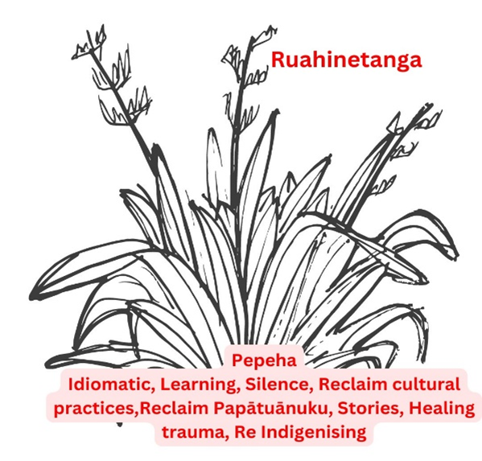
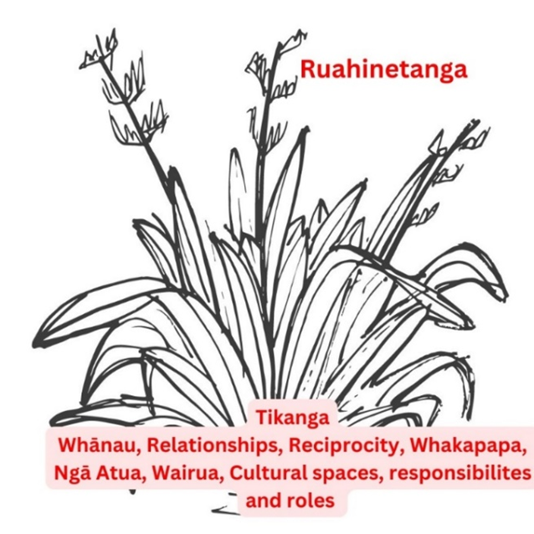
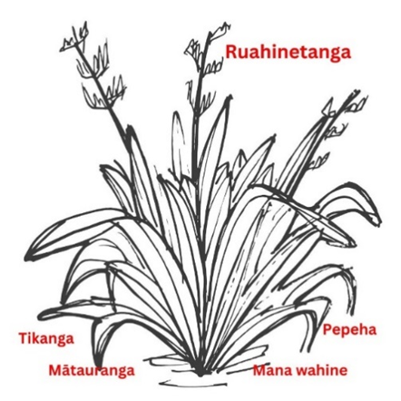
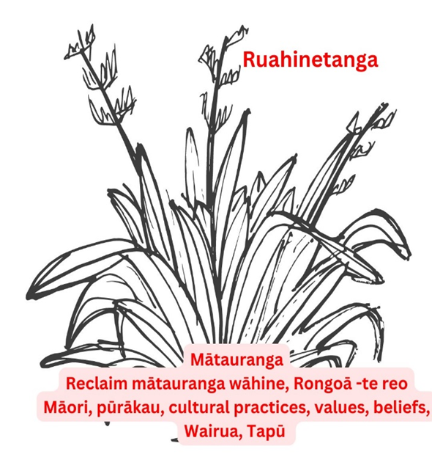
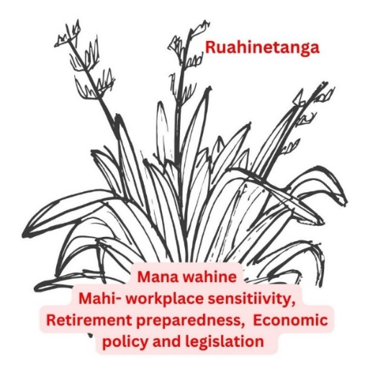
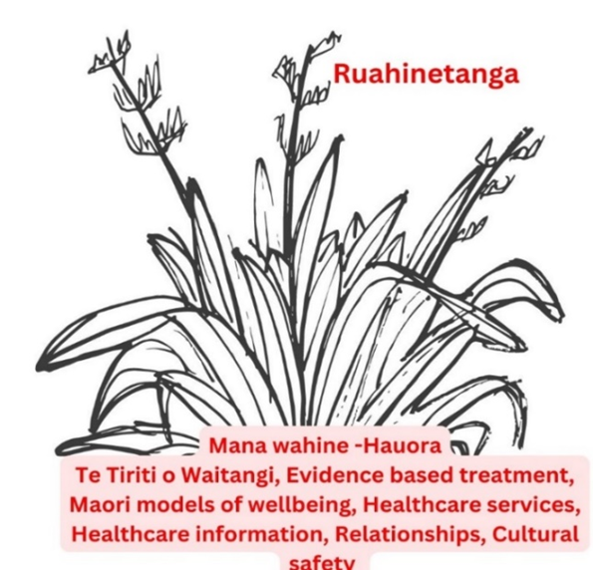
Te ao Māori understandings of menopause are Pepeha, Tikanga, Māturanga and Mana wahine. These interlinked concepts make up the roots of the Harakeke. Aspects of these concepts are discussed in this pukapuka. The idea is that the roots of the Harakeke come to influence our conscious and lived experience of menopause.

Slide 6

Pepeha
How does pepeha shape menopause ?

Slide 7
Learning in silence
Ruahinetanga:
…I learned about it from friends, and I remember when I was younger, I would listen to Mum and her friends laughing about it, so from other women too
… I went to a wananga about 10 years ago now, with this woman; I can’t remember her name. It was so empowering and liberating for me, and it made me think, ‘Why wasn’t it like this in my whanau? Why were we made to feel paru about periods or about our bodies?
He aha tō whakaaro?
Notes

Slide 8
Moko kauae /Pāpatūānuku
Ruahinetanga
…As soon as I see a wāhine with a moko kauae, I instantly just think, 'Choice!' I love seeing moko kauae; it makes me feel good just to see it. I don’t have one, but just seeing it makes me feel good. I’ve never really thought about this before, but here I am now thinking that’s how powerful moko is; just seeing it makes me proud and happy…
…I love seeing our young ones are claiming it, rocking it, and empowering it; however, in our generation there is still that feeling of 'Am I worthy?' But of course we are… We have whakapapa…
…When I see, or am on, or by, my maunga, she gives me a sense of peace in stressful times of life. I go to her when I need some awhi or clarity …
He aha tō whakaaro?
Notes

Slide 9
Papatūānuku
“I doubt many of us would consider it too great a stretch of the imagination to describe the present-day desecration of Papatūānuku as an extreme form of sexual violence. In reality, the rape of Papatūānuku is almost inevitable in light of the fact that Pākehā land tenure, positions her as neither an Atua nor ancestress, but rather as the property of men.” ( Ani Mikaere, 2013, p.92)
“Women are the first environment. We are privileged to be the doorway to life. At the breast of women, the generations are nourished and sustained. From the bodies of women flow the relationship of those generations both to society and to the natural world. In this way is the earth our mother, the old people said. In this way, we as women are earth.” (Cook, 2003, p. 2).

Slide 10

Mātauranga
How can mātauranga shape menopause ?

Slide 11
Mātauranga- te reo
Ruahinetanga
…Te reo is a slow journey I am on. I am not good at learning languages; I wish I had done it when I was younger and when my brain was more switched on. Heoi anō, when I look at the meanings of kupu, I see what a beautiful language that carries and explains te ao Māori. 'Mokopuna' is one such word. Coming to understand myself through this world has been transformational on my wairua, my hingengaro, my tinana, and my whānau…
…As I have gotten older, I have become more interested in te ao Māori and learning to speak te reo Māori. I have struggled with the latter, so I am on a journey that has taken me years, and I am still getting there. Does this journey make me feel good at this point in my life? Yes, it does. My son and I both are learning in classes together; it’s pretty awesome…
…Te reo is a Rongoā for us all; it is 100% important in this journey…
He aha tō whakaaro?
Notes

Slide 12
Mātauranga – Pūrākau
Ruahinetanga
…I think our culture has so many metaphors that speak to the power of women. The whare of the marae where people walk through is walking through a woman’s vagina - I love it!...by the way, you are entering a woman’s vagina on your way through…. That’s not made clear when people are entering a marae. Knowing this as an older woman fills my cup, it speaks to my power and helps me to face the challenges I face in my work, as a mother, as a member of my community…
…The importance of the feminine essence, te ahua o te wāhine, in our creation stories. Yeah, like Hine-nui-te-pō – Māori were not afraid to talk about incest – I like the way that her power is expressed when she kills Maui with her vagina! Overall, there are many stories about the power of women – even the construction of the wharenui – this shows that Māori were open, and women had power. These remind me of our power as wāhine since the beginning of time! And it has had a positive effect on my outlook as I get older as I have realised that I have more influence in the direction of the lives of my children and mokopuna by modelling what they could be…
He aha tō whakaaro?
Notes

Slide 13

Tikanga
How does tikanga shape menopause ?

Slide 14
Tikanga- Ceremonial spaces
Ruahinetanga
…My role as I have aged has changed personally on the marae. I am the Kaikaranga on my own marae, and I have been asked to do this on other marae; for me, these are very prestigious moments. I remember my first time, being nervous; however, at the same time, it was also comforting, like I was destined to be there at the moment, it was real, or like part of what I should be doing. It’s difficult to put into words…
,,,Menopause is definitely a time when you can bloom, you know, like when you’re a kaikaranga on the marae, and it’s when you start to move to those sorts of roles…
…Karanga hits you deep. It’s an instant example of wairua, and it reminds you of the great privilege to be a mama, to be able to create life and bring babies into the world, and it’s ours, it feels good to know that …
Karanga is not the only way that ruahine recognise tikanga, there are many other rituals, practices, spaces and relationships where tikanga is enacted. Tikanga provides space for ruahine to be empowered to reconnect with ancestral knowledge and their roles as spiritual and cultural leaders, and as protectors and keepers of knowledge. This reconnection supports holistic hauora and enables ruahine to live in alignment with te ao Māori cultural values.
He aha tō whakaaro?
Notes

Slide 15
Ceremonial practices
…Sometimes I do Karakia when I am trying to kia tau, and I use whakataukī to keep my wairua going, and that keeps me going…
…I use the Maramataka, following the calendar for times to rest, time to work, taking time for wellbeing and honouring my tinana. I began using Maramataka to guide my mahi, te rakanui to go hard, and Tamatea to take rest. Now, when things are tough or I have heaps on my plate, I know time to rest is coming…. It helps to manage the busy times…there is a light at the end of the tunnel…well, a new moon anyway…
…I am really excited that Matariki is now being recognised, we use Matariki to reflect on our whānau achievements, valuing our whānau challenges, honouring our tūpuna and making time for this is reassuring for myself and whānau. It keeps us connected; this supports and continues to support my wellbeing through menopause. Knowing we are continuing on the traditions of our tūpuna is a great feeling. One I want my whānau to experience. All of these, I was in practice these whilst my menopause flew past me…
He aha tō whakaaro?
Notes

Slide 16
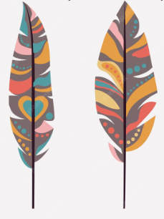
Indigenous women
She's pulling the baby out of the Earth, out of the water, or a dark wet place. It is full of ecological context. We know from our traditional teachings that the waters of the earth and the waters of our bodies are the same water. The follicular fluid which bathes the ripening ovum on the ovary; the dew of the morning grass; the waters of the streams and rivers and the currents of the oceans - all these waters respond to the pull of our Grandmother Moon. She calls them to rise and fall in her rhythm. Mother's milk forms from the bloodstream of the woman. The waters of our bloodstream and the waters of the earth are all the same water. (Cook, 2003, p.1)

Slide 17
Mana wahine -Ruahine me Mahi
What is menopause and work like?

Slide 18
Menopause and mahi
Ruahinetanga
…The long and the short of it was that because of the bleeding, I was very anaemic, and so that obviously contributed to my tiredness and irritability. Anyway, I had to go and have some iron transfusions, so I had to talk to my manager about taking time off. My manager was a Samoan man; I would say in his 30s. Shaaaaame, man, I did not want to have that conversation with him… Oh hey, I have to have some time off because I’ve had really heavy vaginal bleeding … I didn’t think he would even know what menopause is, anyway. I started to say I’m anaemic and need to get iron transfusions, and then I just got so whakamā I lied and said I mean my mum was sick and I had to take her to her doctor’s appointments. I did not want to tell him about my bloody, literally bloody, menopause. Basically, it’s not an environment where you can be open about that sort of stuff, or any stuff really…
…I think it needs to be taken more seriously at work; some countries are pushing for menopause leave. Work was harder because of brain fog and heightened emotions, also lack of sleep due to night sweats…
He aha tō whakaaro?
Notes

Slide 19

Mana wahine- Hauora taha Tinana
Menopause and Hauora tinana...

Slide 20
Menopause and Hauora-Healthcare
…Doctor unsafe place, very black and white, and sent home with a list of instructions; there is no understanding for who I am, there is no wairua. Plus, it’s not cheap, and it takes so much time to get there, wait to see them and then get back home again – what’s the point for something I can find on Google…
… I've been to the doctor maybe eight times about what I presumed to be menopause. I mean, I had all the symptoms of what you would see in menopause, but they never really brought it up, but I am the right age, I have the symptoms, and so it must be right? Anyway, they don’t seem to really listen, but the cost adds up, plus I am busy, really too busy to go and wait in the doctor’s clinic while they run 45 minutes late for my appointment. Then I’m in the room for about 5 minutes; he takes my blood pressure, nods his head, thinks it’s viral, gives me some Panadol, and then tells me to come back in a couple of weeks if I’m not feeling better. Hell, is there something not right with this picture… It doesn’t take a genius; I get so hōhā just thinking about it…
He aha tō whakaaro?
Notes

Slide 21
Mana wahine and Tinana
…Brain fog and heightened emotions – also lack of sleep due to night sweats…
…When I am tired, it makes my physical symptoms worse. At the end of the day, my leg is sore. I am grumpy with my tamariki, and I hate being a grumpy mama. I have a real lack of sleep; I think I always have. I ended up taking some homeopathic stuff, and whether it was placebo effect or not, I didn't care once I started sleeping; things got better. Menopause made that worse…
…My experience was because I didn’t know about it, who would know if a cramp or flush was menopause related or related to being mauiui. I was too busy to be concerned anyway…
…I had a breakdown, I got so low and was having suicidal thoughts, it was just awful, when I look back, nothing significantly had changed except for my age and going through menopause. I had to take 6 weeks off work, and the doctor put me on antidepressants and HRT. I don’t know if it was the anti-depressants or the HRT that helped here, or whether I had just sort of come to a point in my life where I took control…
He aha tō whakaaro?
Notes
If you want more information or support please reach out ruahinetanga@gmail.com or your Healthcare provider

Slide 22
References
Bullivant, K. (2025). Wāhine Māori, menopause and the Harakeke. [Unpublished Doctoral Thesis}. Te whare wānanga o Awanuiārangi
Cook, K. (2003). Women are the first environment. Indian Country Today. https://ictnews.org/archive/cook-women-are-the-first-environment
Mikaere, A. (2013). Colonising myths -Māori realities: He rukuruku whakaaro. Huia Publishers
Copyright ©
This resource is the property of Kelly Bullivant. You have permission to read and reference this for the purpose of research, on the agreement that you comply with the provisions of the Copyright Act 1994 (New Zealand). Any reproduction of this content must have permission from the author. Copyright 2024 asserted by Kelly Bullivant in New Zealand.

